Slide 1
Development of an Augmented Reality Based eLearning Tool for Teaching the Basics of Harmonic Theory
Leon Brooks
16.01.2023
Final: Bachelor of Informatics: Games Engineering
Supervisor: Prof. Dr. Gudrun Klinker
Advisor: M.Sc. Sven Liedtke

Slide 2
Motivation
14 years of playing piano
Annoyed at reading introductions slandering sheet music
AR provides a unique opportunity for immersive holistic music education
Prototype an AR app for music theory
Could not find research on this specific combination of topics

Slide 3
Problem Description: Issues
Research relate works with different combinations of the topics AR, music (theory), pedagogy/education
Condense into design guidelines
Use guidelines for requirements analysis
Design application
Implement
Run User Study
Reflect on the whole process

Slide 4
Related Work: AR + Music
Music Tutoring apps:
O. Cakmakci, F. Bérard, and J. Coutaz. (2003): “An augmented reality based learning assistant for electric bass guitar.”
J. Chow, H. Feng, R. Amor, and B. C. Wünsche. (2013): “Music education using augmented reality with a head mounted display.”
D. Hackl and C. Anthes. (2017): “HoloKeys-An Augmented Reality Application for Learning the Piano.”
B. Patzer, D. C. Smith, and J. R. Keebler. (2014): “Novelty and retention for two augmented reality learning systems.”

Slide 5
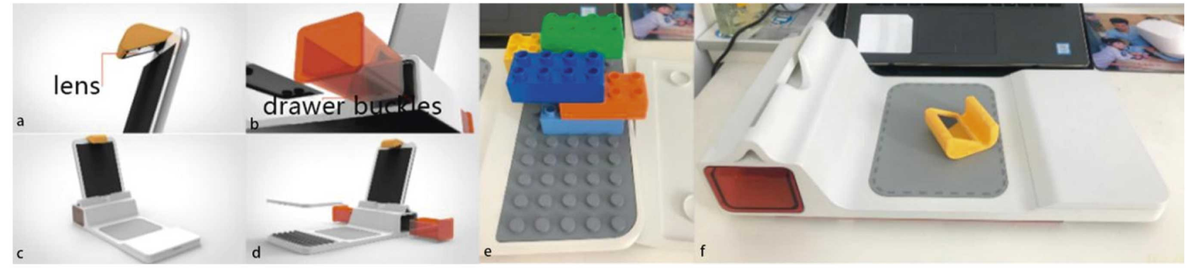
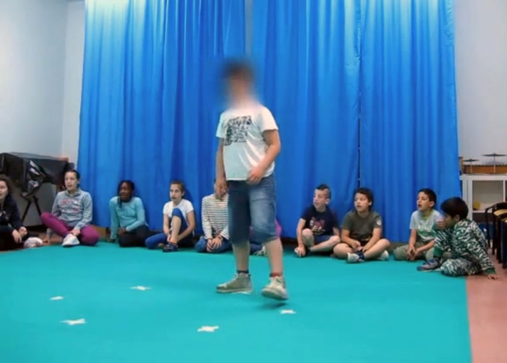
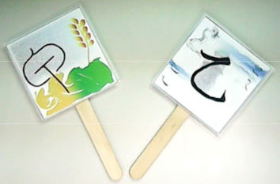
Related Work: AR + Music Theory
Y. Lu, X. Wang, J. Gong, and Y. Liang
(2022)
F. Avanzini, A. Barate, C. Mauro, L. A. Ludovico, and M. Marcella
(2020)
S.-Y. Ho, W.-W. Jiang, Y.-M. Yu, and M.-Z. Li
(2017)

Slide 6
Related Work: AR + Pedagogy
General Advantages:
Can improve content understanding if implemented correctly
Early studies show higher knowledge retention
Users commonly score motivation/enjoyment highly
Affordances of AR (Santos et al; 2014):
Real world annotation: info boxes
Context visualization: familiar and/or real-world context
Vison-haptic visualization: touching things or getting the body involved (embodiment)

Slide 7
Related Work: AR + Pedagogy
AR Design Guidelines (Dunleavy, 2014):
Enable and then challenge: avoid cognitive overload
Drive by gamified story: narrative story and usage of unique features (e.g. location)
See the unseen: visualized concepts and invisible things (e.g. displaying organs over a human body model)

Slide 8
Related Work: Music Theory + Pedagogy
College level classroom case study (Callahan, 2015):
Fill in the blank questions
Keyboard helpful for visualization
Hearing is very helpful
Improved motivation

Slide 9
Software Design
General Requirements:
Teach harmonic theory
Include sheet music
Include Keyboard + sound
Integrating Affordances of AR:
Real world annotation: annotate important sheet music elements + use coloring
Context visualization: not feasible
Vison-haptic visualization: touchable keyboard + note dragging (real keyboard not feasible)

Slide 10
Software Design
Integrating AR Design Guidelines:
Enable and then challenge: use text-to-speech to avoid visual overload
Drive by gamified story: not feasible/focus
See the unseen: emphasize relationship between keyboard and sheet music through synchronous changes

Slide 11
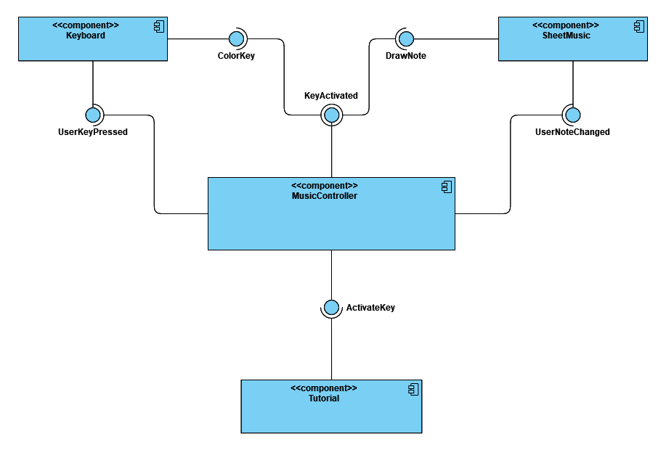
Software Design

Slide 12
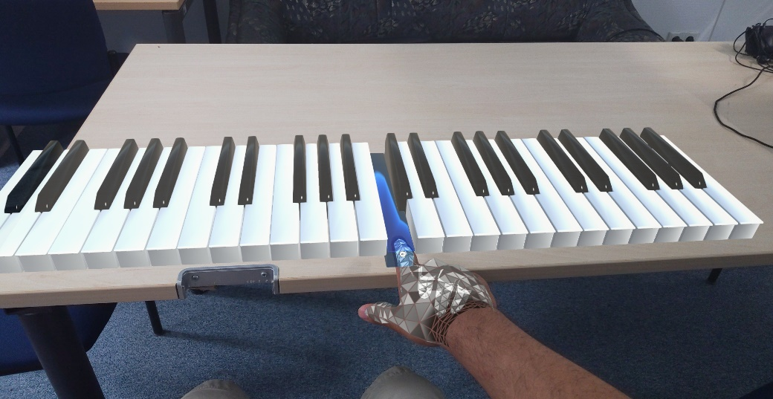
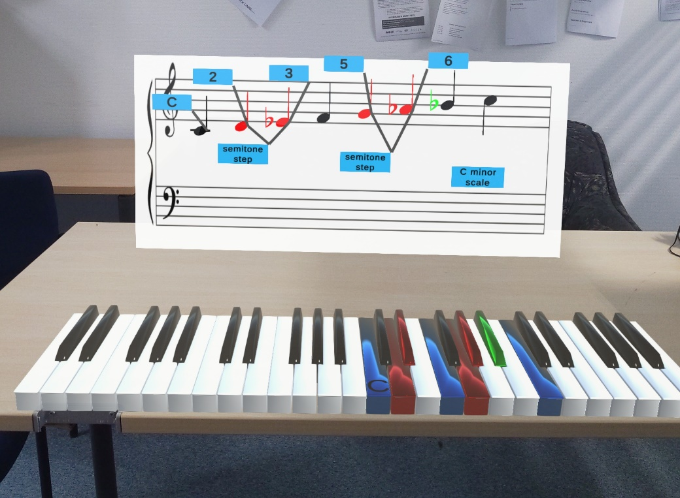
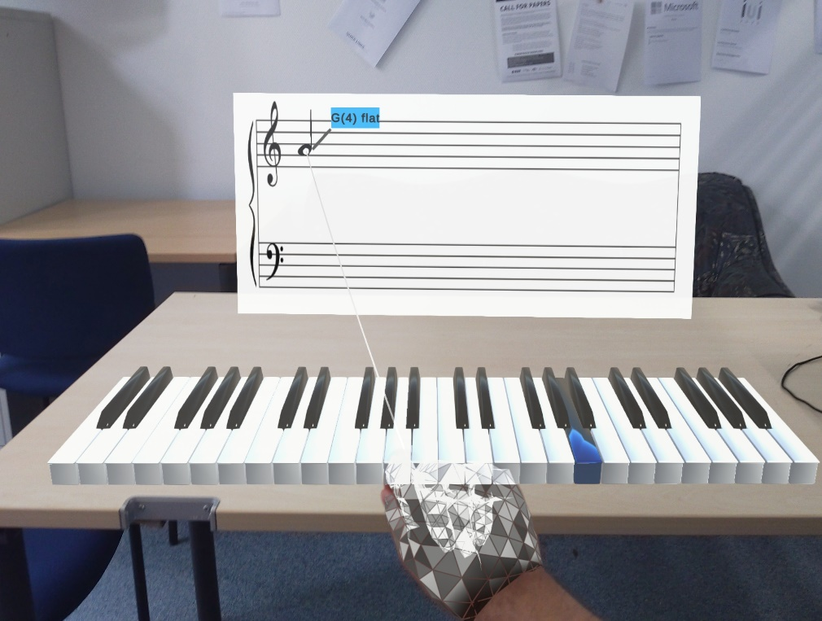

Slide 13
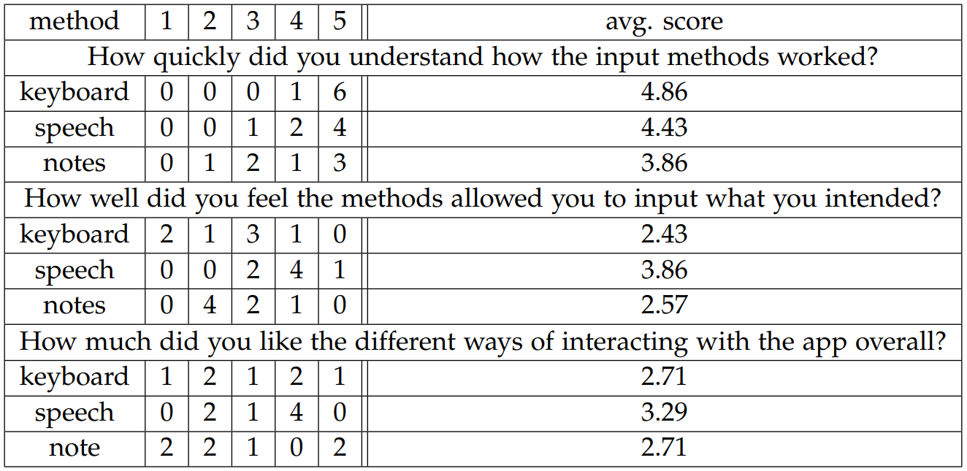
User Study (n=7)
Input Method Evaluation

Slide 14
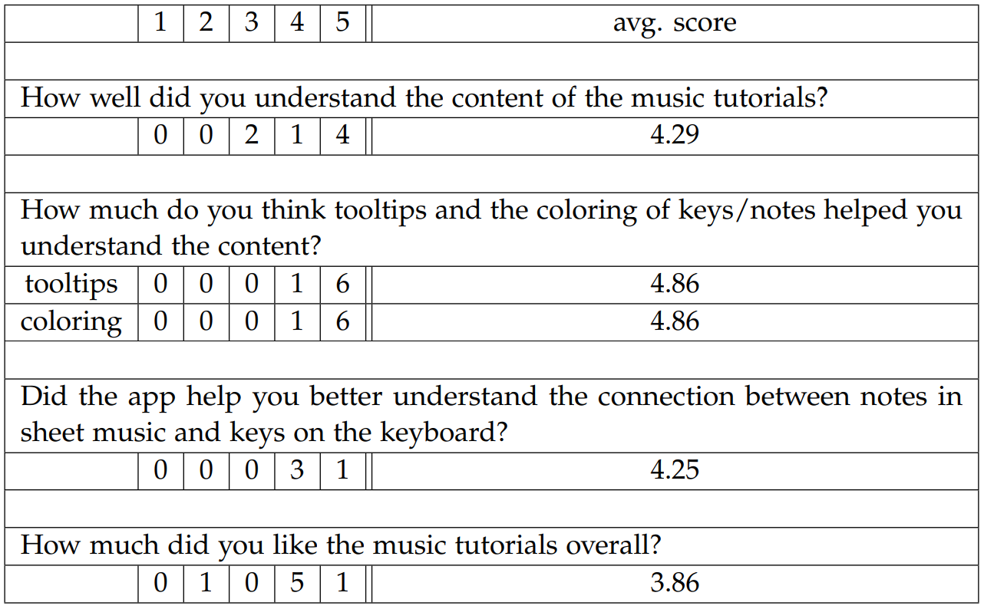
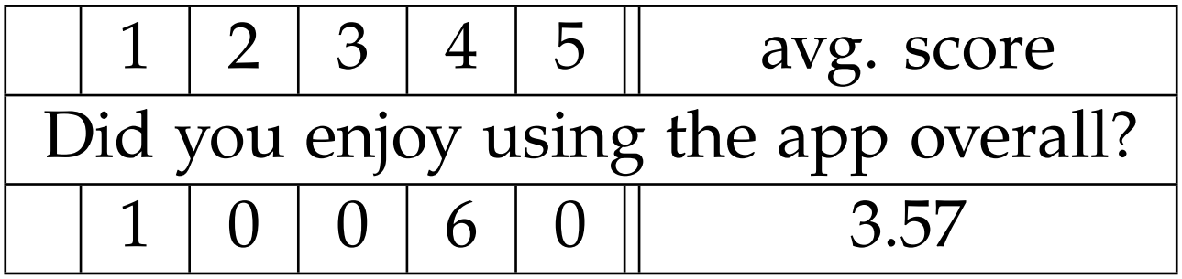
User Study (n=7)
Tutorial Evaluation
Overall Score

Slide 15
Key Takaways
Software Design:
Notes ≠ Keys
Multidirectional messaging/input can get confusing
One tone
Plan these systems in great detail
Usability (Hololens):
Limited field of view => creative solutions
Barrier of entry => gesture needed?
good tutorials
Hand Tracking limited => only simple tasks

Slide 16
Outlook
Physical Keyboard, possibly with overlay
(Hackl et al; 2015 and Huang et al; 2011)
Gamification
Narrative
More pedagogy

Slide 17
List of References
…
…

